Slide 1
BANKING
CUSTOMER BEHAVIOUR AND CHURN ANALYSIS
Ashutosh Shukla

Slide 2



Business Problem Definition
Determining the different factors that contribute to Banking Customers becoming former customers to reduce customer churn

Slide 3

Dataset Overview
Number of Products
Has Credit Card
Is Active Member
Complaint
Satisfaction Score
Dataset had 35 Features

Slide 4
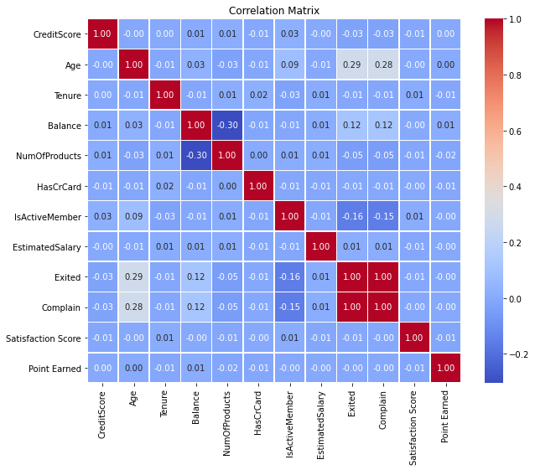
Correlation Heat MAP

Slide 5
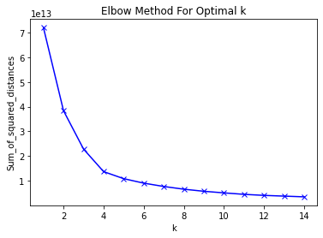
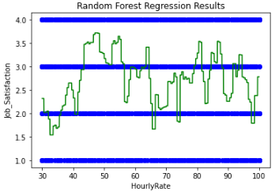
ELBOW METHOD

Slide 6
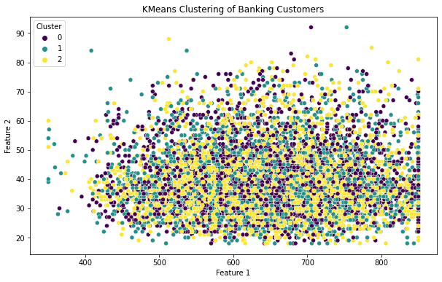
CLUSTERING

Slide 7
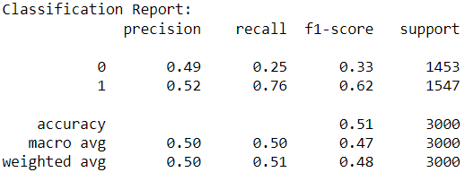
Classification report and accuracy
Accuracy: 0.5113333333333333

Slide 8


Conclusion
There is no specific feature that results in a customer leaving a bank

